Slide 1
An App for the Disabled
Name
Institution Affiliation

Slide 2
Executive Summary
The following is a presentation of a project for developing a mobile app for disabled.
The app will have the features of reporting the status of pathways and helping the individuals in their navigations.
The main competitors for the app will include the Google Map and AXS Map.

Slide 3
Problem Statement
The current assistance for mobility that is available for disabled people is scanty.
The available assistance is static and cannot be modified to suit individual needs and environmental changes (Poon, 2016)
A lot of challenges are experienced by the disabled people due to changing environments.
An example is blooming constructions and frequent obstruction of pathways, which hinder their mobility.
The current navigation apps have not filled this gap.

Slide 4
Importance of the App
A new App known as NavigationApp V.1 will be helpful to the disabled people.
This app will help the individuals in navigating subways even when they will be obstructed.
The app will integrate a feature of Reporting, which will help the users in identifying obstructions on their intended pathways.
It will facilitate in helping the disabled people in either navigating obstructed pathways or using other alternative routes.

Slide 5
Evidence
The population of people living with disability in US has to 12.6% in 2015 from 11.9 % in 2010 (Institute of Disability, 2016).
By 2015, only 34.9% of the people with disability aged between 18-64 was employed, leaving 76.0 % being unemployed.
More than 21.2% of the disabled people within the working class live poverty (Institute of Disability, 2016).

Slide 6
App Description
The App will be downloadable into the smartphones of the users.
It will include navigation features that will report the status of the path before the users starts the journey.
The App will include the feature of navigation through obstructed pathways.
It will have the features of locating the position of the users relative to landmarks such as buildings and their homes.

Slide 7
Target Market
The App targets the market of the disabled.
This market comprises of the people who use wheel chairs but are visually capable.
It is expected that this market will be economically viable to sustain the business operations of the App
The navigation App will solve their mobility challenges through giving them directions.

Slide 8
App Description
The App will not need the users to be connected to the internet, since it will be accessible as an application from the phone.
It is expected that the App will be upgraded frequently to give the users an improved experience.
The users are expected to have smartphones to access the App.

Slide 9
Competition
The main competitor for the app will be Google Map.
However, the competitor has not filled the gap of reporting obstruction on pathway.
The gap will be an advantage to NavigationApp V.1.
Competition is also expected from other similar apps such as AXS Map and ChiSafePath, which are already in the market (Poon, 2016).
The feature of Customization for this app is expected counter the stiff competition.

Slide 10
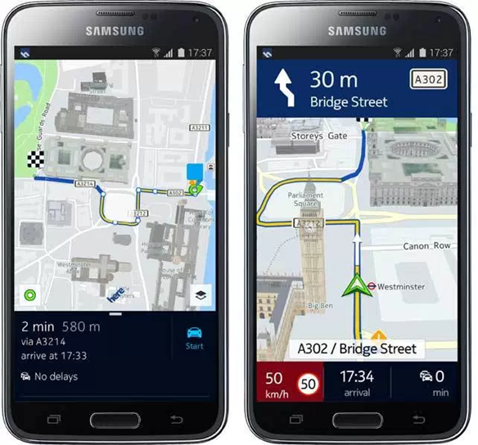
Navigation (source: Google)

Slide 11
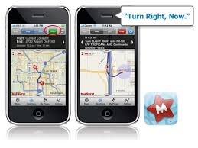
App Navigation (source : Google)

Slide 12
App Development Team
The development and management of the App will need different professionals.
The project will include a project manager, who will provide oversight to the entire team.
A team of six software developers will be involved in developing and testing the App.
A marketing team, comprising of four professionals will be required in marketing the App.

Slide 13
Enumeration
The project manager will be employed on a permanent contract.
It is estimated that the App will be ready in the market in five months.
The software developers will therefore be employed on a five months contract, each receiving a salary of 10,000 dollars.
The marketing team will be employed on permanent basis, with each member receiving a basic salary of 6,000 dollars.

Slide 14
Customer Benefit
The customers will benefit from the advantage of navigating through obstructed pathways.
The app will give a benefit of reporting the status of pathways to the customers before they leave their homes.
Customers will benefit from the feature of customization of the app to suit their needs.
Another advantage that the app will provide is its compatibility with Android and OS of many mobile phones.

Slide 15
Risks
Cyber attack is the major expected risk.
The current trends in cyber crime affect the development of apps which is a major risk to data and systems (Dayhouse, 2010).
The development of the app may experience the risk of sudden growth in requirements of the project.
A risk of breaking down the specification may be experienced during the process of integrating and coding information.

Slide 16
Implementation
The implementation of the project will involve a pilot test to identify deviations that will need to be readdressed.
The status of business in developing the app will be a limited liability company.
This status will be chosen since it is ideal in incorporate other actors such as financiers.
The financing of the project is expected to made by NGOs that work with People Living With Disabilities (PLWD)

Slide 17
Conclusion
The development of a similar app would involve a collaboration between actors such as mobile phone operators.
However, this project will not involve this collaboration because it might be extremely expensive.
The development will instead involve developing an app that is compatible with android and OS.
These are the common systems which are mostly used in mobile phones.

Slide 18
References
Poon, L. (2016) How Apps Can Help People with Disabilities Navigate Cities.
Dayhouse, T (2010). The Growing Security Threat for Mobile App.
Institute of Disability (2016). 2016 Disability Annual Report. University of New Hampshire

